Slide 1

Data Warehouse Project
Supermarket project

Slide 2
Introduction my Self
Name: Youssef Azam Mahfouz Mohamed
Education:
Studying at the Faculty of Computers and Artificial Intelligence, Beni Suef University
Specializing in Data Engineering
Project:
Title: Building a Data Warehouse for a Supermarket
Objective: To design and implement a comprehensive data warehouse that supports supermarket operations and provides actionable business insights.

Slide 3

Agenda
Introduction
Project Goals
Entity-Relationship Diagram (ERD)
Schema
Database Creation in MSSQL
Gathering Business Information
Data Modeling
Data Warehouse
ETL Process in SSIS
Reporting in Power BI
Project Timeline
Conclusion

Slide 4

Introduction
Gola of project : In the modern retail landscape, efficient and accurate data management is crucial for the smooth operation and success of any supermarket. The Supermarket Management System Database project aims to develop a comprehensive database solution that streamlines various aspects of supermarket operations, from inventory management and sales tracking to customer relationship management and business analytics.
This project will encompass the entire lifecycle of database development, including the design, implementation, and deployment phases. The end goal is to create a robust and scalable database in Microsoft SQL Server (MSSQL) that supports the supermarket's business needs and provides actionable insights through advanced reporting and data analytics tools such as Power BI.

Slide 5

Project Goals
Create ERD: Design a detailed Entity-Relationship Diagram (ERD) for supermarket operations.
Convert ERD to Schema: Translate the ERD into a formal database schema with all necessary tables, keys, and constraints.
Create Database in MSSQL: Implement the schema in Microsoft SQL Server, setting up the database structure.
Gather Business Information: Identify key business questions to guide decision-making.
Create Data Model: Develop a data model optimized for performance and scalability.
Create Data Warehouse: Design and implement a data warehouse for comprehensive reporting and analysis.
ETL in SSIS: Use SQL Server Integration Services (SSIS) to develop an ETL process to populate the data warehouse.
Create Reports in Power BI: Develop interactive reports in Power BI to visualize data and provide business intelligence.

Slide 6
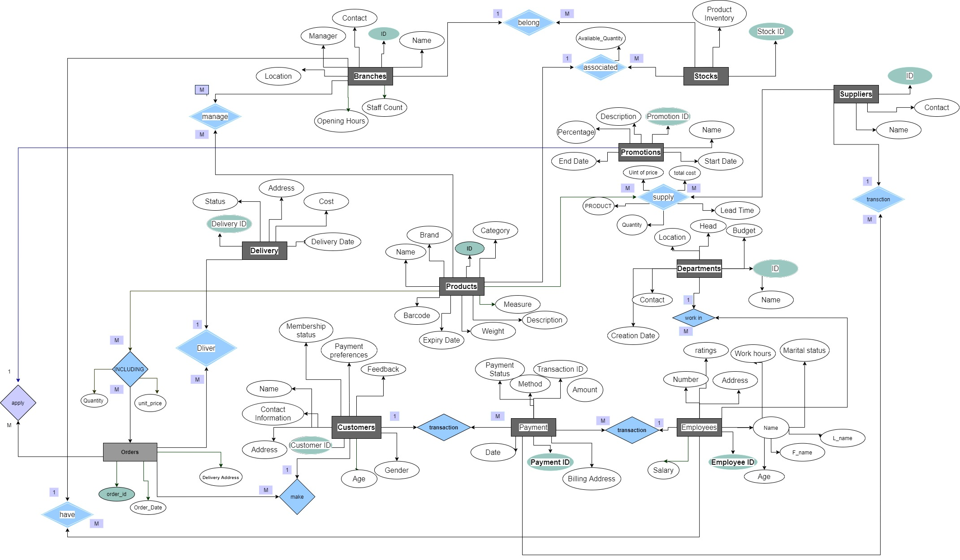
Entity-Relationship Diagram (ERD)

Slide 7
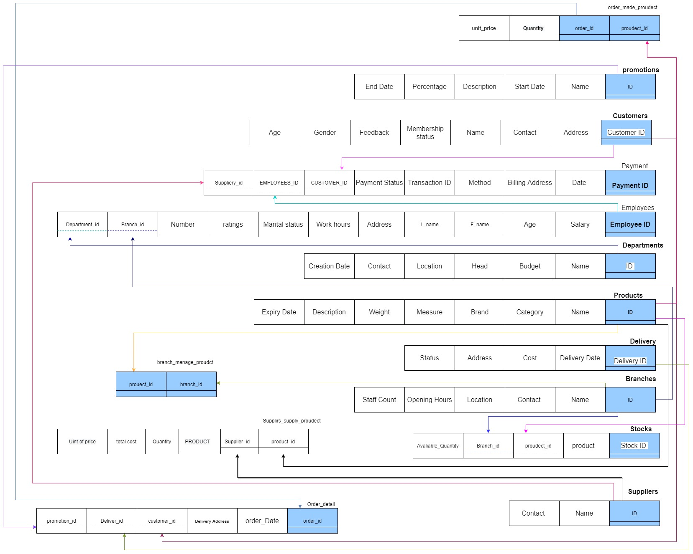
Schema

Slide 8

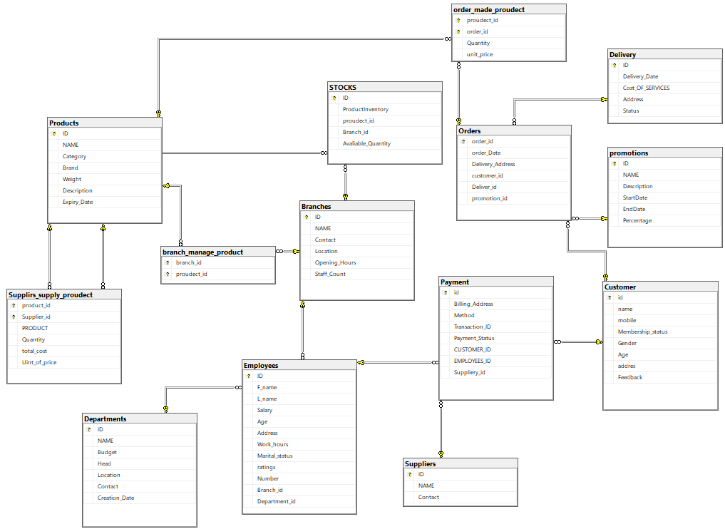
Database Creation in MSSQL

Slide 9
Business Information Questions ?
What are the total sales revenue and quantity sold for each product category?
How do sales vary over time, and can we identify any seasonal trends or patterns?
Which branches are the top performers in terms of sales revenue and profit margin?
What is the sales performance of employees in each branch and department, and who are the top 10 sales representatives and their managers?
What are the current inventory levels of each product in each branch, and how does inventory turnover vary across different product categories and branches?
Which promotions result in the highest increase in sales revenue, and can we quantify the ROI for each promotion campaign?

Slide 10
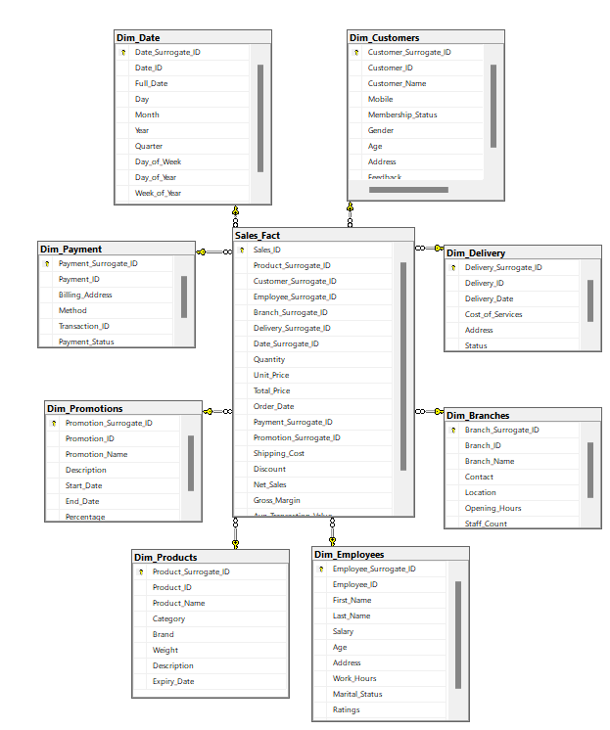
Data Warehouse Design

Slide 11
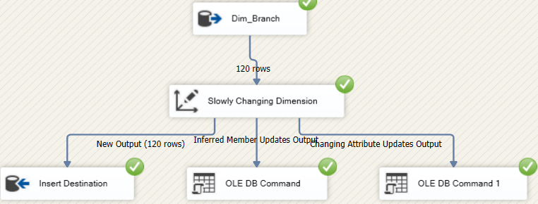
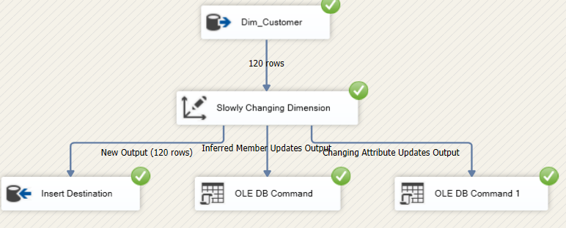
ETL Process in SSIS
Dim Branches
Dim_Customer

Slide 12
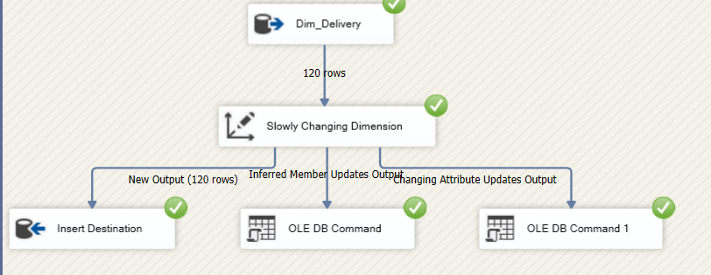
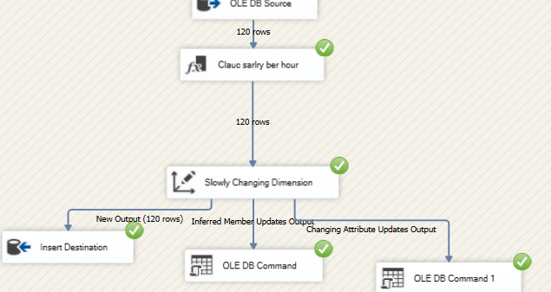
ETL Process in SSIS
Dim_Delivery
Dim_Employee

Slide 13
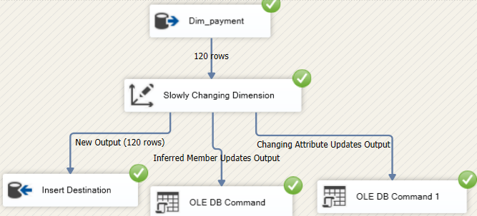
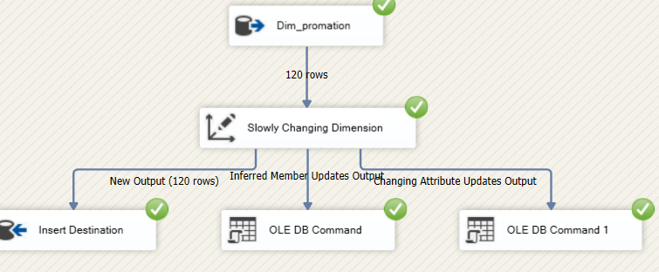
ETL Process in SSIS
Dim_payment
Dim_promation

Slide 14
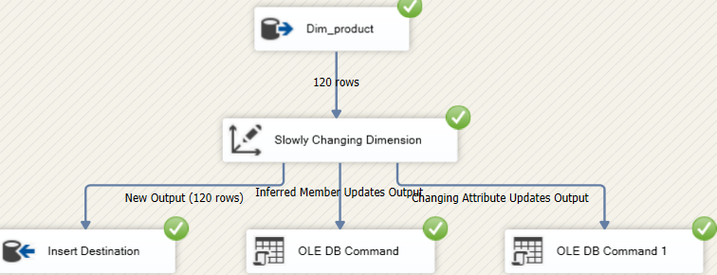
ETL Process in SSIS
Dim_product

Slide 15
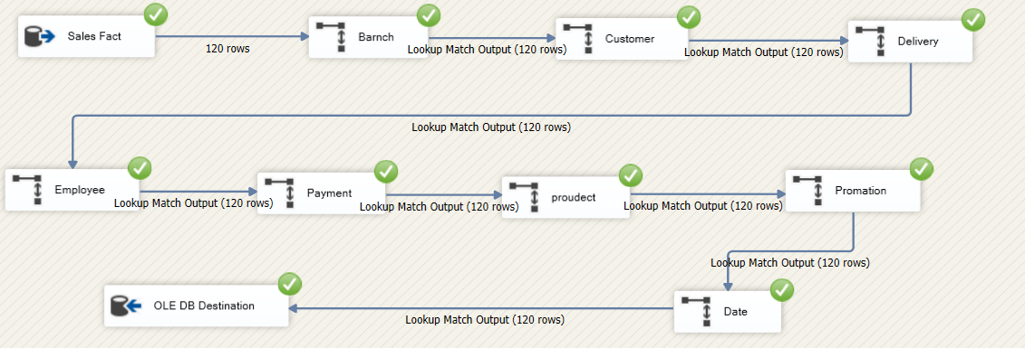
ETL Process in SSIS
Sales Fact

Slide 16
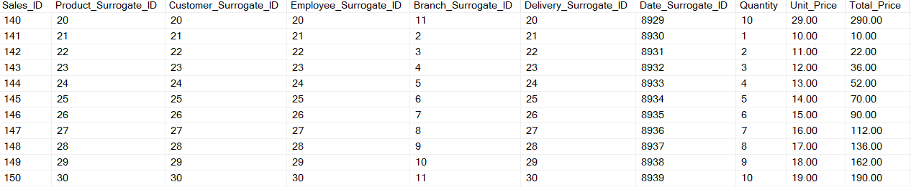
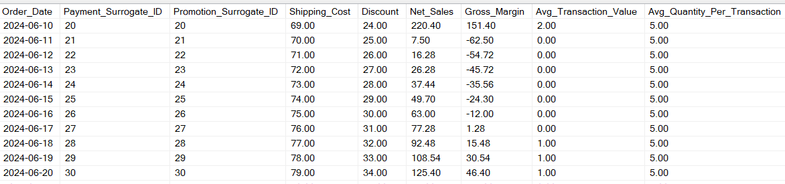
Date in FACT

Slide 17
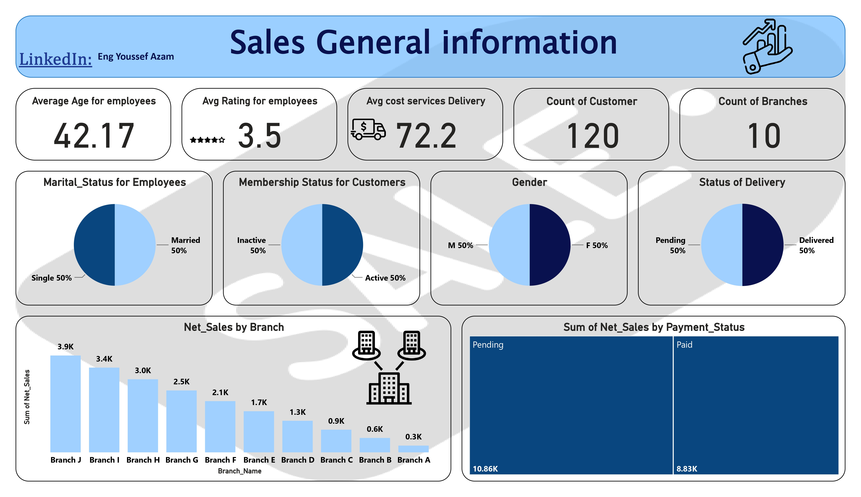

Slide 18
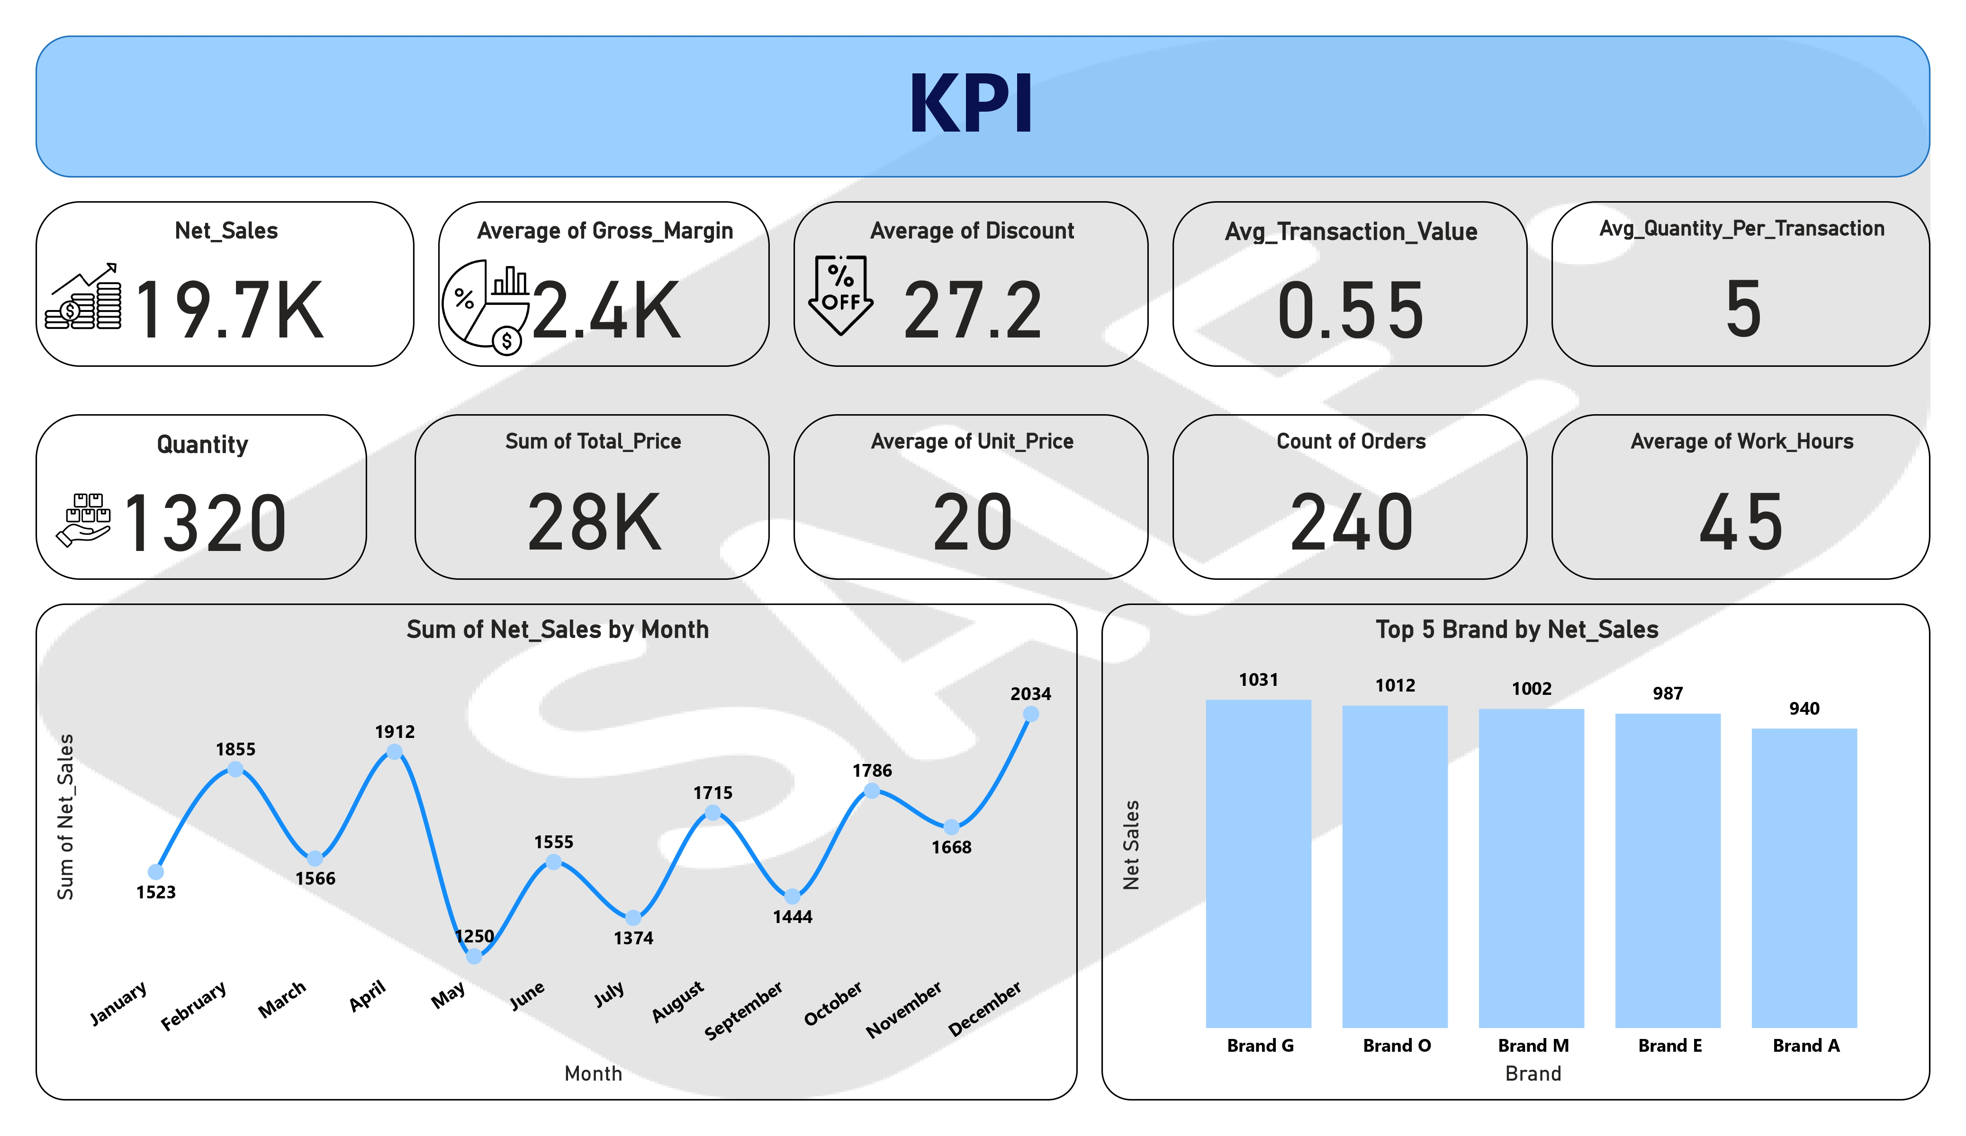

Slide 19
Project Timeline
Week 1:
Entity-Relationship Diagram (ERD)
Schema
Review
Week 2:
Database Creation in MSSQL
Gathering Business Information
Review
Week 3:
Data Modeling
Data Warehouse
Review
Week 4:
ETL Process in SSIS
Reporting in Power BI
Review and Final Adjustments

Slide 20
Conclusion
The Supermarket Management System Database project is a comprehensive initiative that will significantly enhance the operational efficiency and decision-making capabilities of a supermarket. Through meticulous design, robust implementation, and advanced reporting, this project aims to deliver a powerful tool for managing and analyzing supermarket data. The successful completion of this project will not only streamline daily operations but also provide valuable insights that drive business growth.

